Slide 1
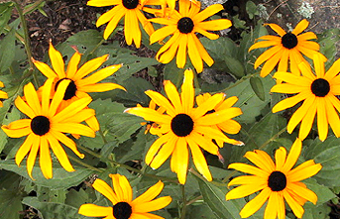
Native
Black-eyed Susan

Slide 2
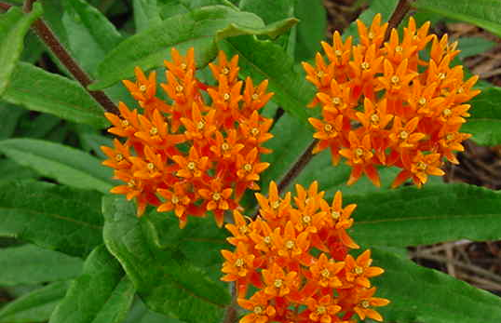
Native
Butterfly weed

Slide 3
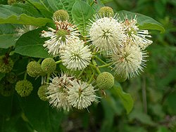
Native
Button-bush

Slide 4
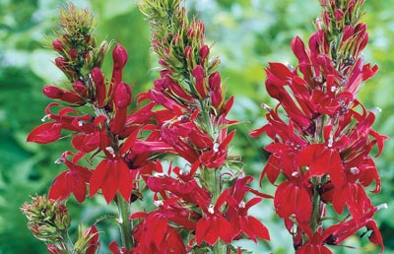
Native
Cardinal flower

Slide 5
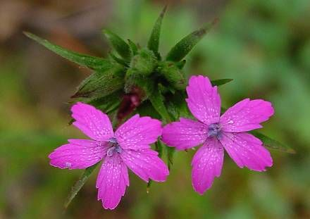
Native
Depford pink

Slide 6
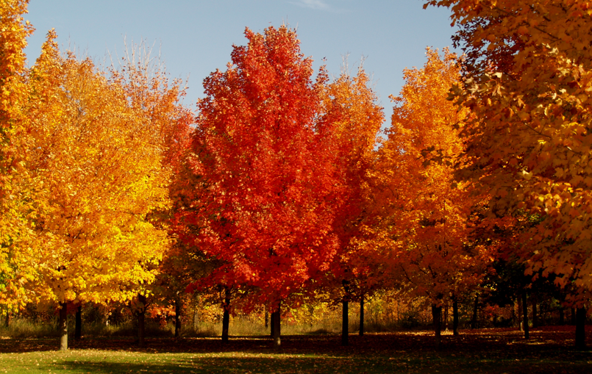
Native
Sugar maple

Slide 7
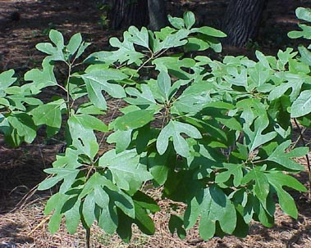
Native
Sassafras

Slide 8
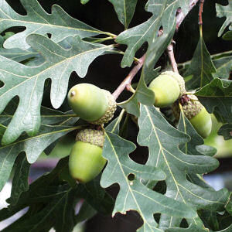
Native
White Oak

Slide 9
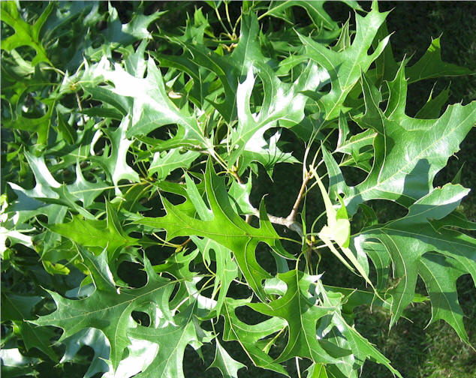
Native
Pin Oak

Slide 10
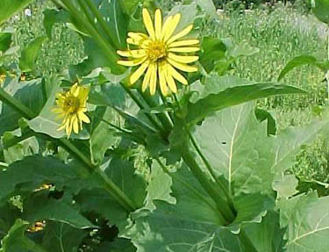
Native
Cup plant

Slide 11
Native
Showy goldenrod

Slide 12
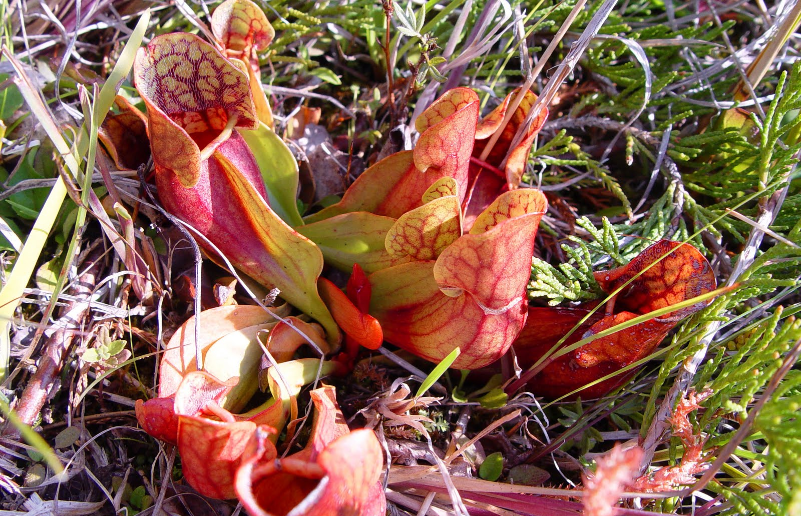
Native
Pitcher plant

Slide 13
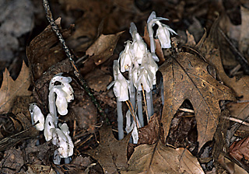
Native
Indian pipe

Slide 14
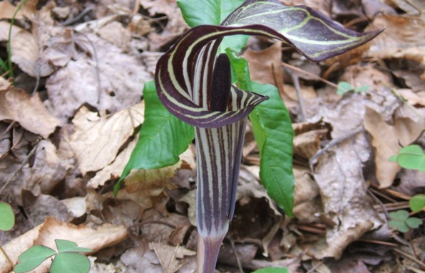
Native
Jack in the pulpit

Slide 15
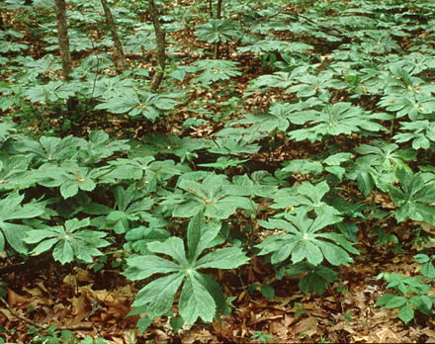
Native
Mayapple

Slide 16
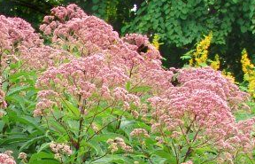
Native
Joe pye weed

Slide 17
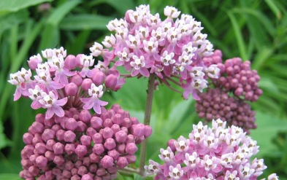
Native
Common milkweed

Slide 18
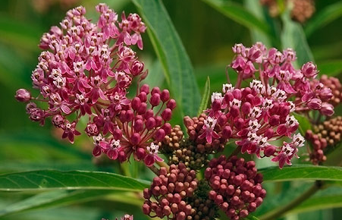
Native
Swamp milkweed

Slide 19
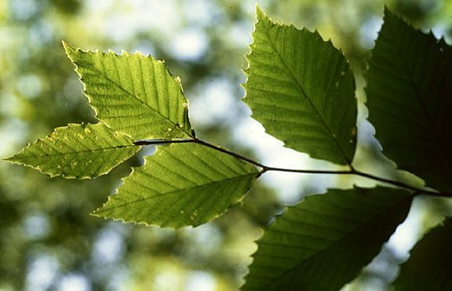
Native
American beech

Slide 20
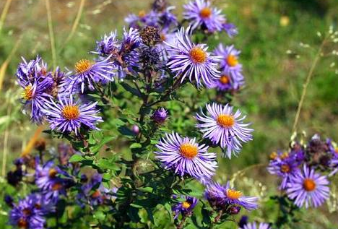
Native
New England aster

Slide 21
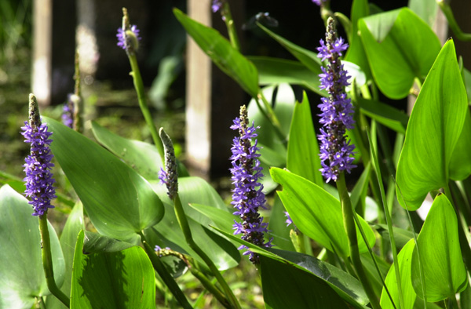
Native
Pickerel-weed

Slide 22
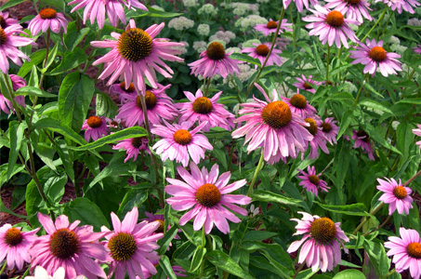
Native
Purple coneflower

Slide 23
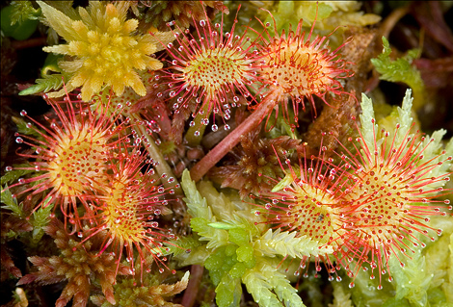
Native
Round leaved Sundew

Slide 24
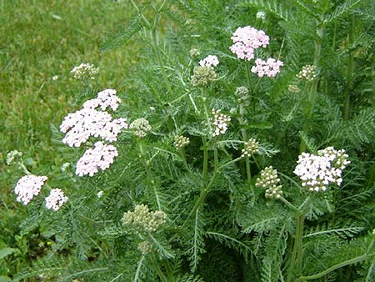
Native
Yarrow

Slide 25
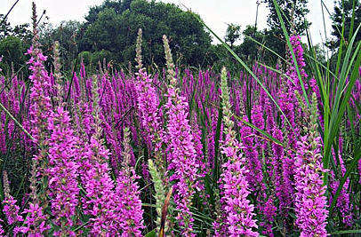
Invasive
Purple loosestrife

Slide 26
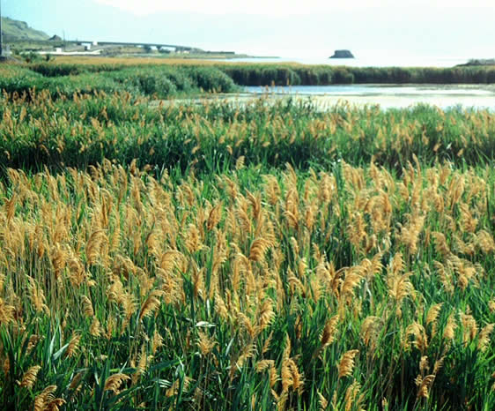
Invasive
Phragmites

Slide 27
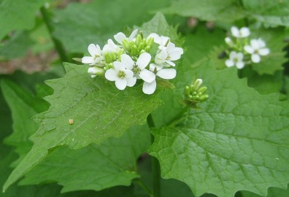
Invasive
Garlic mustard

Slide 28
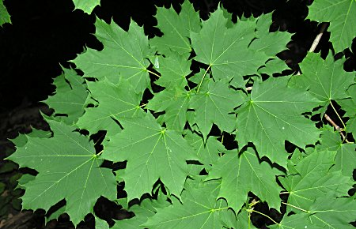
Invasive
Norway maple

Slide 29
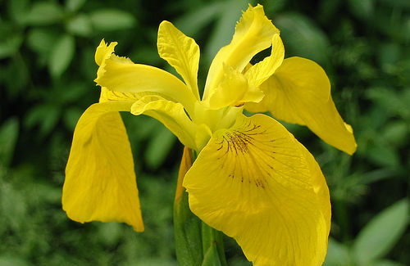
Invasive
Yellow flag iris

Slide 30
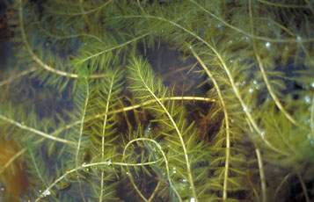
Invasive
Eurasian watermilfoil

Slide 31
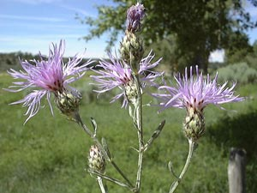
Invasive
Spotted knapweed

Slide 32
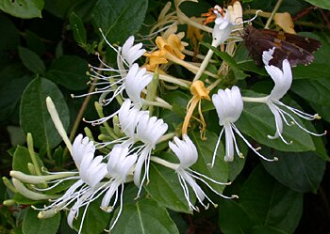
Invasive
Japanese honeysuckle

Slide 33
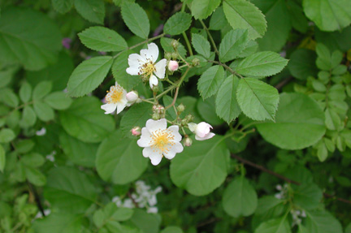
Invasive
Multiflora rose

Slide 34
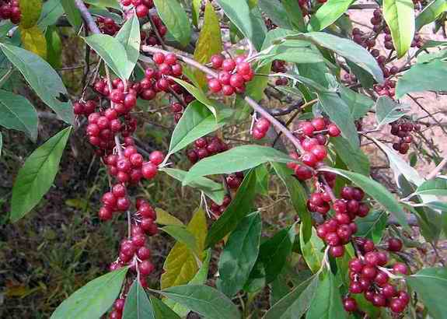
Invasive
Autumn olive

Slide 35
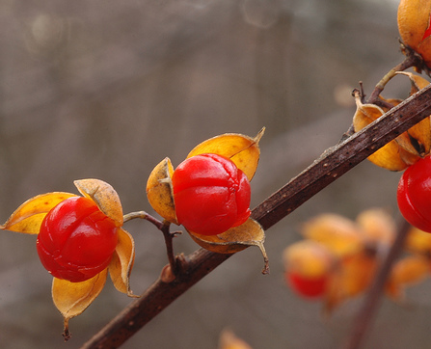
Invasive
Bittersweet

Slide 36
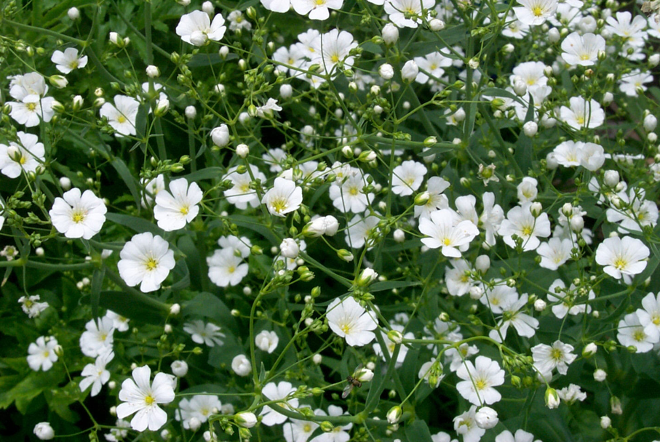
Invasive
Baby’s breath

Slide 37
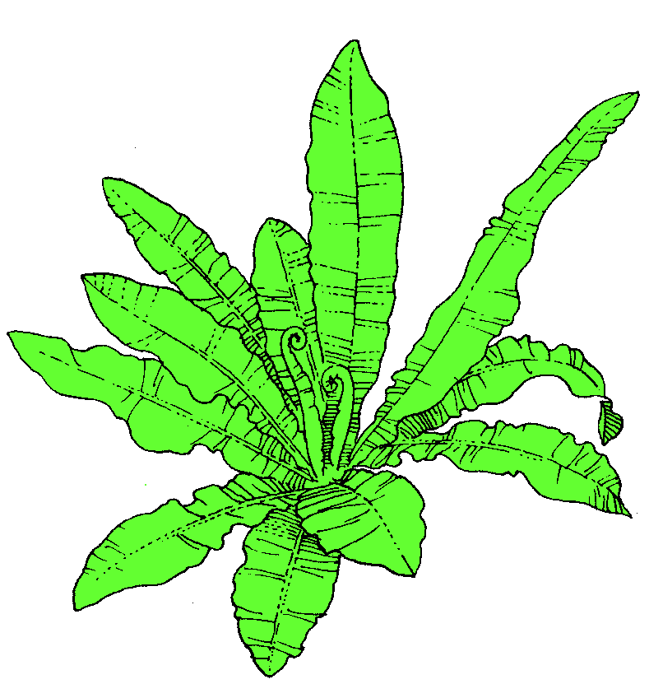
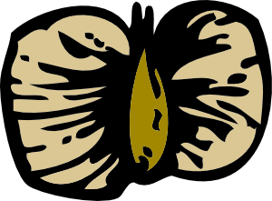
Black-eyed Susan
Move forward:
Growth:
Seeds:
Disperse:
Move backward:
Herbivory:
Disease:
Fire:
Drought:
Human disturbance:

Slide 38
Yarrow
Move forward:
Growth:
Seeds:
Disperse:
Move backward:
Herbivory:
Disease:
Fire:
Drought:
Human disturbance:

Slide 39
N.E. Aster
Move forward:
Growth:
Seeds:
Disperse:
Move backward:
Herbivory:
Disease:
Fire:
Drought:
Human disturbance:

Slide 40
Joe Pye Weed
Move forward:
Growth:
Seeds:
Disperse:
Move backward:
Herbivory:
Disease:
Fire:
Drought:
Human disturbance:

Slide 41
Pitcher Plant
Move forward:
Growth:
Seeds:
Disperse:
Move backward:
Herbivory:
Disease:
Fire:
Drought:
Human disturbance:

Slide 42
White OAk
Move forward:
Growth:
Seeds:
Disperse:
Move backward:
Herbivory:
Disease:
Fire:
Drought:
Human disturbance:

Slide 43
Pin Oak
Move forward:
Growth:
Seeds:
Disperse:
Move backward:
Herbivory:
Disease:
Fire:
Drought:
Human disturbance:

Slide 44
American Beech
Move forward:
Growth:
Seeds:
Disperse:
Move backward:
Herbivory:
Disease:
Fire:
Drought:
Human disturbance:

Slide 45
Sugar Maple
Move forward:
Growth:
Seeds:
Disperse:
Move backward:
Herbivory:
Disease:
Fire:
Drought:
Human disturbance:

Slide 46
Cardinal Flower
Move forward:
Growth:
Seeds:
Disperse:
Move backward:
Herbivory:
Disease:
Fire:
Drought:
Human disturbance:

Slide 47
Sundew
Move forward:
Growth:
Seeds:
Disperse:
Move backward:
Herbivory:
Disease:
Fire:
Drought:
Human disturbance:

Slide 48
Mayapple
Move forward:
Growth:
Seeds:
Disperse:
Move backward:
Herbivory:
Disease:
Fire:
Drought:
Human disturbance:

Slide 49
Goldenrod
Move forward:
Growth:
Seeds:
Disperse:
Move backward:
Herbivory:
Disease:
Fire:
Drought:
Human disturbance:

Slide 50
Sassafras
Move forward:
Growth:
Seeds:
Disperse:
Move backward:
Herbivory:
Disease:
Fire:
Drought:
Human disturbance:

Slide 51
Buttonbush
Move forward:
Growth:
Seeds:
Disperse:
Move backward:
Herbivory:
Disease:
Fire:
Drought:
Human disturbance:

Slide 52
Purple Coneflower
Move forward:
Growth:
Seeds:
Disperse:
Move backward:
Herbivory:
Disease:
Fire:
Drought:
Human disturbance:

Slide 53
Swamp Milkweed
Move forward:
Growth:
Seeds:
Disperse:
Move backward:
Herbivory:
Disease:
Fire:
Drought:
Human disturbance:

Slide 54
Common Milkweed
Move forward:
Growth:
Seeds:
Disperse:
Move backward:
Herbivory:
Disease:
Fire:
Drought:
Human disturbance:

Slide 55
Butterfly Weed
Move forward:
Growth:
Seeds:
Disperse:
Move backward:
Herbivory:
Disease:
Fire:
Drought:
Human disturbance:

Slide 56
Jack in the Pulpit
Move forward:
Growth:
Seeds:
Disperse:
Move backward:
Herbivory:
Disease:
Fire:
Drought:
Human disturbance:

Slide 57
Cup Plant
Move forward:
Growth:
Seeds:
Disperse:
Move backward:
Herbivory:
Disease:
Fire:
Drought:
Human disturbance:

Slide 58
PickerelWeed
Move forward:
Growth:
Seeds:
Disperse:
Move backward:
Herbivory:
Disease:
Fire:
Drought:
Human disturbance:

Slide 59
Indian Pipe
Move forward:
Growth:
Seeds:
Disperse:
Move backward:
Herbivory:
Disease:
Fire:
Drought:
Human disturbance:

Slide 60
Depford Pink
Move forward:
Growth:
Seeds:
Disperse:
Move backward:
Herbivory:
Disease:
Fire:
Drought:
Human disturbance:

Slide 61
Black-Eyed Susan
Move forward:
Growth:
Seeds:
Disperse:
Move backward:
Herbivory:
Disease:
Fire:
Drought:
Human disturbance:

Slide 62
Autumn Olive
Move forward:
Growth:
Seeds:
Disperse:
Move backward:
Herbivory:
Disease:
Fire:
Drought:
Human disturbance:

Slide 63
Watermilfoil
Move forward:
Growth:
Seeds:
Disperse:
Move backward:
Herbivory:
Disease:
Fire:
Drought:
Human disturbance:

Slide 64
Phragmites
Move forward:
Growth:
Seeds:
Disperse:
Move backward:
Herbivory:
Disease:
Fire:
Drought:
Human disturbance:

Slide 65
Multiflora Rose
Move forward:
Growth:
Seeds:
Disperse:
Move backward:
Herbivory:
Disease:
Fire:
Drought:
Human disturbance:

Slide 66
Yellow Flag Iris
Move forward:
Growth:
Seeds:
Disperse:
Move backward:
Herbivory:
Disease:
Fire:
Drought:
Human disturbance:

Slide 67
Purple Loosetrife
Move forward:
Growth:
Seeds:
Disperse:
Move backward:
Herbivory:
Disease:
Fire:
Drought:
Human disturbance:

Slide 68
Baby’s Breath
Move forward:
Growth:
Seeds:
Disperse:
Move backward:
Herbivory:
Disease:
Fire:
Drought:
Human disturbance:

Slide 69
Honeysuckle
Move forward:
Growth:
Seeds:
Disperse:
Move backward:
Herbivory:
Disease:
Fire:
Drought:
Human disturbance:

Slide 70
Norway Maple
Move forward:
Growth:
Seeds:
Disperse:
Move backward:
Herbivory:
Disease:
Fire:
Drought:
Human disturbance:

Slide 71
Bittersweet
Move forward:
Growth:
Seeds:
Disperse:
Move backward:
Herbivory:
Disease:
Fire:
Drought:
Human disturbance:

Slide 72
Knapweed
Move forward:
Growth:
Seeds:
Disperse:
Move backward:
Herbivory:
Disease:
Fire:
Drought:
Human disturbance:

Slide 73
Garlic Mustard
Move forward:
Growth:
Seeds:
Disperse:
Move backward:
Herbivory:
Disease:
Fire:
Drought:
Human disturbance:

